Slide 1
Arduino Night
Part 1
Presenter: Dave (Proto)

Slide 2
Agenda
UAS Information
Instructor Introduction
Board overview
What is “Arduino”
Intro to the IDE
Upload Serial & LED “Hello World” Programs
Fading LED
Questions

Slide 3
UAS Information

Slide 4
Who's the Schmuck?
Started Arduino ~ 2 years ago
Taught Arduino Night for ~ 5 months
Also teach FPGA
Currently a Java developer

Slide 5
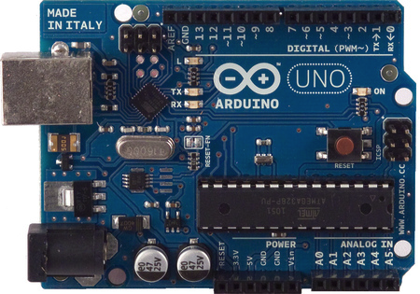
Board Overview
Arduino UNO

Slide 6
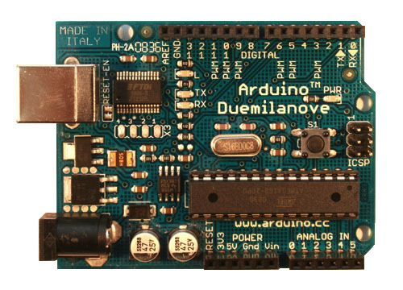
Board Overview
Arduino Duemilanove

Slide 7
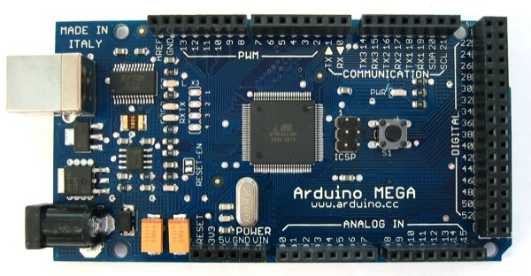
Board Overview
Arduino Mega

Slide 8
What is “Arduino”
A nifty board
Based off of Atmel AVR chips
“Arduino” is a friendlier library than AVR C
“digitalWrite(pin,value)” rather than “PORTD=(0x01 & value) << pin”
Standard board layout for “Shields”
Bootloader to get data onto chip
Atmega 328P (UNO) can be used alone

Slide 9
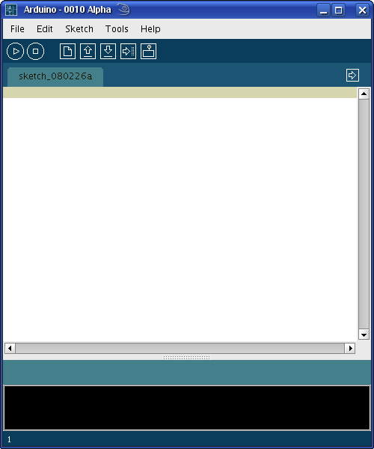
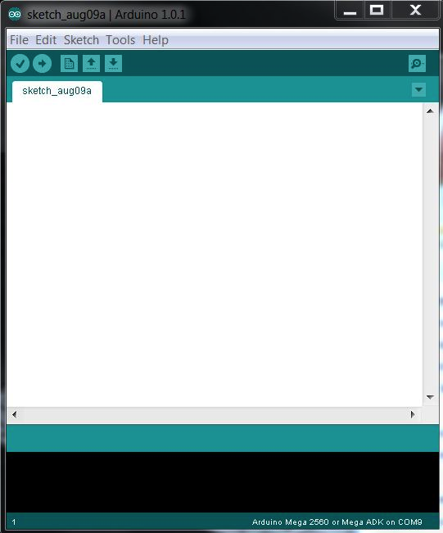
Intro to the IDE
Download from http://www.arduino.cc

Slide 10
Arduino IDE Tips
Linux – Might have to run the IDE as root (sudo)
Linux – Serial port will be /dev/ttyUSBX
Windows – Serial port will be COMX
Windows – Check device manager for number

Slide 11
Arduino IDE – Opening Files
Arduino IDE files are .pde
Files can be written using “Arduino C”, AVR C, and assembly
Libraries are built in

Slide 12
Serial “Hello World” Program
Uses the Arduino's USB port to talk serial
void setup(){
Serial.begin(9600);
}
void loop(){
Serial.println("Hello World");
delay(3000);
}

Slide 13
Serial “Hello World” Program
All “Sketches” have to define “void setup()” and “void loop()”
Void setup(){} will run when the Arduino first starts
Void loop(){} will be called over and over while the Arduino is powered on
Serial.begin(9600) enabled serial communication at 9600 bauds per second

Slide 14
Serial “Hello World” Program
Delay(3000) causes the code to stall for 3 seconds
Serial.println(“Hello World”) puts the string “Hello World\n” on the serial port

Slide 15
Uploading Serial Program
Click on “Verify” to ensure code is properly formatted.
Make sure the correct board is selected under “Tools”=>”Board”
Connect Arduino to your computer's USB port
Make sure the correct serial/COM port is selected under “Serial Port”
Click “Upload”

Slide 16
Demo
Make sure everyone is up and running!

Slide 17
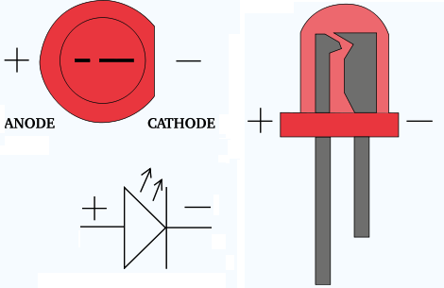
Blinking an LED
Using an LED

Slide 18
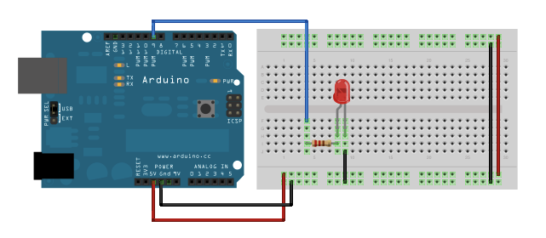
Blinking an LED
Connecting the Arduino to an LED

Slide 19
Blinking an LED
Code
byte outputPin = 9;
void setup(){
pinMode(outputPin, OUTPUT);
}
void loop(){
digitalWrite(outputPin,HIGH);
delay(1000);
digitalWrite(outputPin,LOW);
delay(1000);
}

Slide 20
Blink an LED
byte outputPin = 9 creates a variable called 'outputPin' and assigns it the value of 9
pinMode(pin,mode) sets the pin to be output or input (writing to or reading from)
digitalWrite(pin,value) writes either HIGH or LOW (1 or 0, 5v or 0v) to the specified pin
Verify and upload

Slide 21
Blink an LED
Make sure everyone has a blinking LED

Slide 22
Fading an LED
Blinking turns LEDs on or off
Fading dims the LED
Arduino only has digital outputs
“Analog” is created with PWM
Only certain pins can do PWM

Slide 23
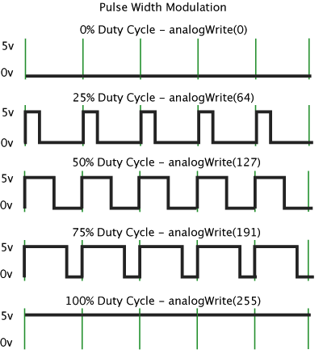
What is PWM
Turns the output on and off at a certain interval
Frequency is constant
Duty cycle is varied
50% = 2.5 volts
75% = 3.75 volts

Slide 24
Using PWM to Fade LED
byte outputPin = 9;
void setup(){
pinMode(outputPin, OUTPUT);
}
void loop(){
for(byte a = 0; a <= 255; a++){
analogWrite(outputPin,a);
delay(250);
}
}

Slide 25
Using PWM to Fade LED
analogWrite(pin, value) writes a value to the specified pin using PWM. Ranges from 0-255
for(byte a = 0; a <= 255; a++){} loops through 256 times (0 to 255)

Slide 26
Fading With PWM
Ensure everyone has a working LED fader

Slide 27

Questions

